Slide 1
DEEP FAKES
CSCI 599 – Applied Machine Learning for Games Prof. Mike Zyda
Adarsh Gopalakrishnan
Niveditha Kumaran

Slide 2
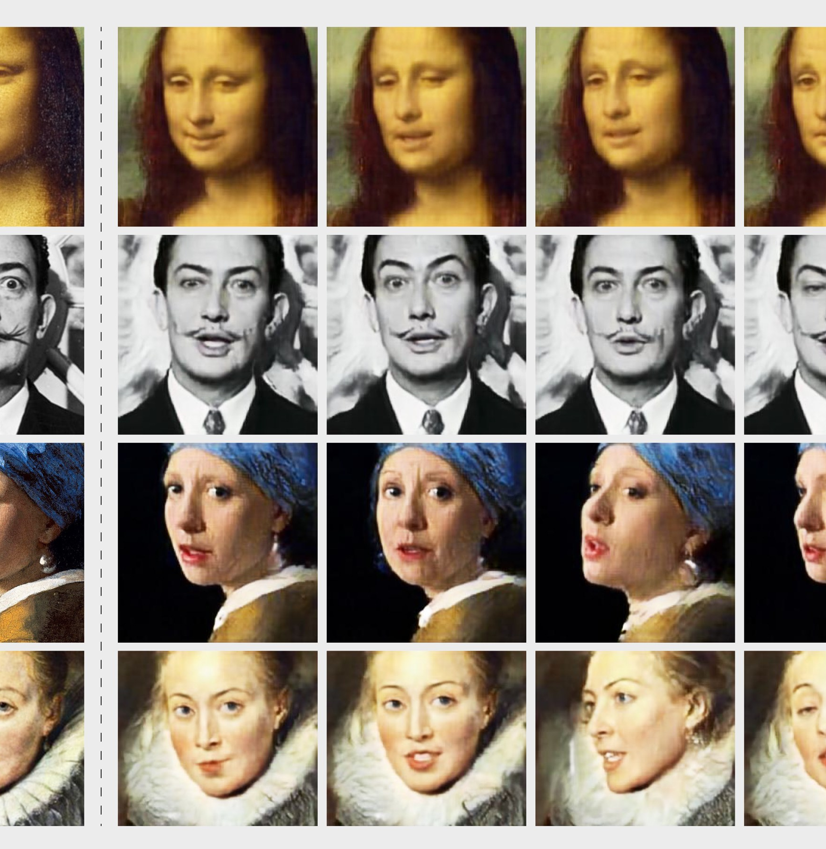
What are deepfakes?
Deepfake is a technique for human image synthesis based on artificial intelligence. It is used to combine and superimpose existing images and videos onto source images or videos using machine learning

Slide 3

PROJECT DETAILS
Goals, Approaches, AutoEncoders, GANs

Slide 4
GOAL
When two objects are under consideration, detect facial features frame by frame and swap the underlying structure
OBJECTIVES
1.Extract faces from videos
2.Pre-process images to facial features
3.Build architecture of GAN and Autoencoder for training
4.Train model to generate swapped faces
5.Convert images to output video

Slide 5
Approaches
Requirement: A model architecture/ algorithm for image-image translation
Generative Adversarial networks
Generator and discriminator work in adversarial manner to generate new image (pitting against each other)
CGANS
Pix-to-pix
CCGANS
Used to recreate an image with required modifications
Auto Encoders
Encoder coupled with a decoder work in unison to recreate the image
Stacked AutoEncoders
Conv-Deconv Auto encoders
GAN like auto encoders
Used to create patterns on existing images

Slide 6
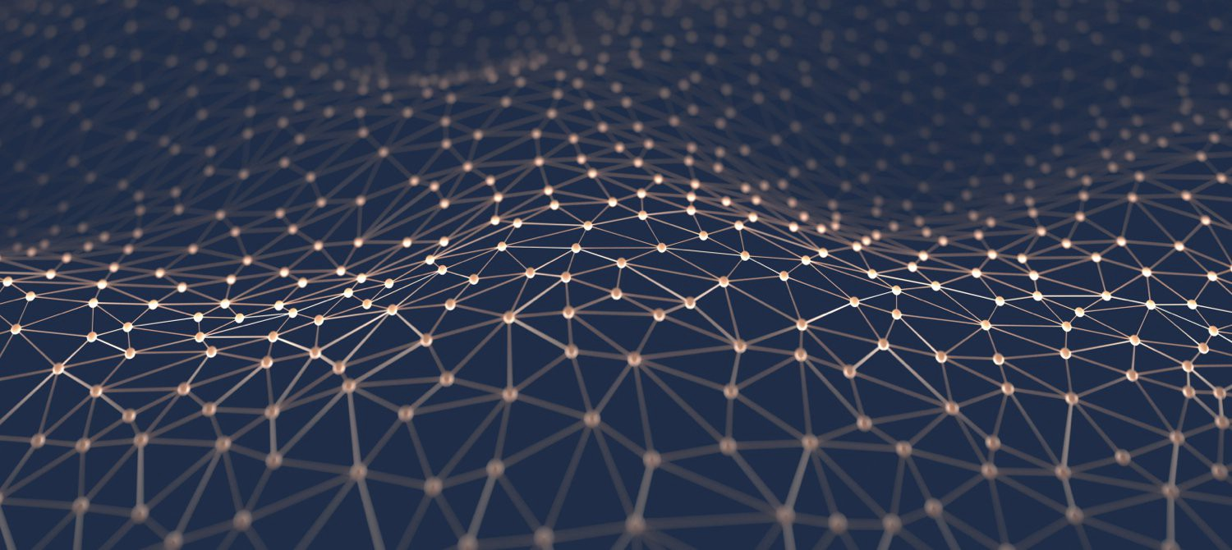
Deep Fakes on Images AUTOENCODER
6

Slide 7
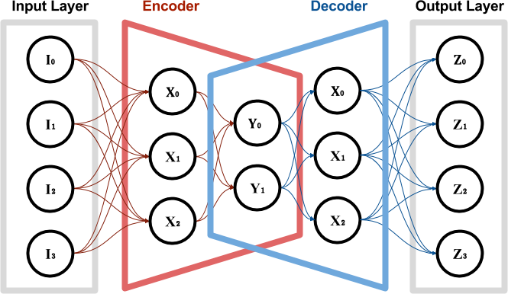
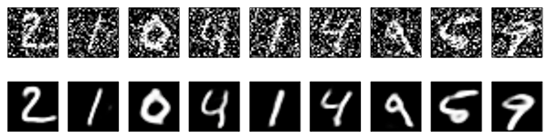
AutoEncoder
ENCODER: Compress the image to reduce dimensions
DECODER: Recreate the image from reduced dimensions
OBJECT OF VALUE: The middle portion/latent space contains important features for future use

Slide 8
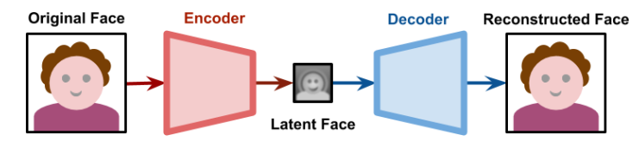
DeepFakes Using AutoEncoder
Basic Idea: Run every image through Autoencoder and store the latent face

Slide 9
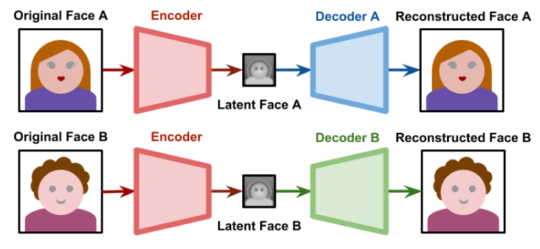
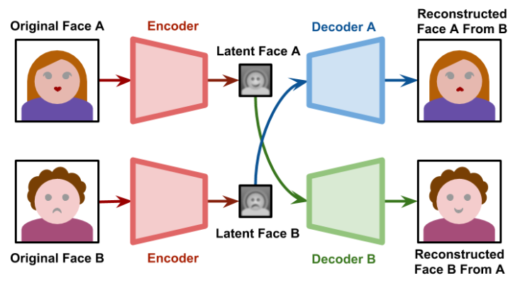
Train Phase
Test Phase

Slide 10
Generative adversarial network

Slide 11
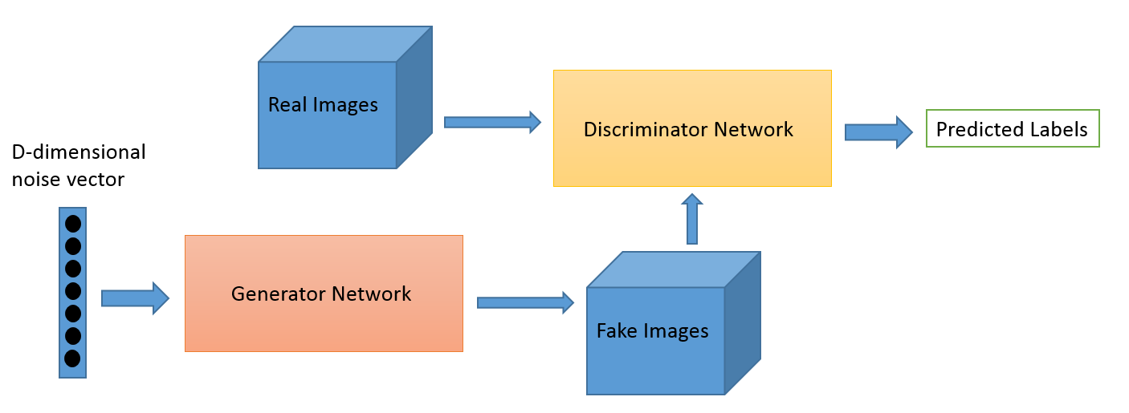
GAN
Two networks ( Generator, Discriminator pitting against each other)

Slide 12

Generator
Generates new data instances
A u-network
Convolution followed by de-convolution
GOAL: generate passable target faces, to lie without being caught.

Slide 13

WORKING
The generator takes in face of object A and returns a B like image (Semi-supervised).
This generated B like image is fed into the discriminator alongside a stream of (real B) images taken from the actual dataset.
The discriminator takes in both real and fake images and returns probabilities, a number between 0 and 1, with 1 representing a prediction of authenticity and 0 representing fake.

Slide 14
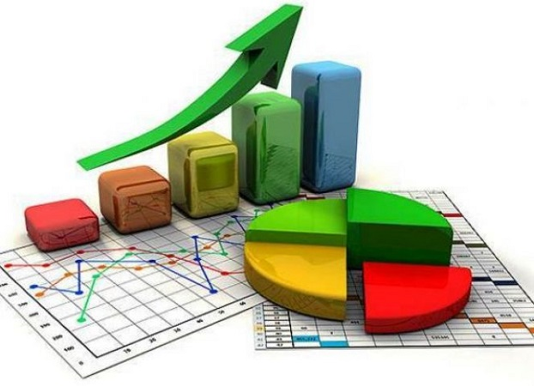
CURRENT PROGRESS

Slide 15



EXTRACTED IMAGES FROM VIDEOS
MTCNN
Joint Face Detection and Alignment using Multi-task Cascaded Convolutional Networks
Extracts Images Frame by Frame
Utilizes VGGFace
Extracted 650 DonaldTrump Images
PRE-PROCESS IMAGES
FACE ALIGNMENT
Detect facial landmarks from using face alignment network, capable of detecting points in both 2D and 3D coordinates.
-Extract binary mask
-Manually clean dataset
-Used Face-Alignement to postion and align eyes
FORMULATE FINAL ARCHITECURE
SAGAN
Self-Attention Generative Adversarial Networks. Benefits of GAN & Autoencoders
Generator architecture is an Autoencoder
Discriminator is a self sustaining Classifier
15

Slide 16
Research DeepFakes
Learn Image Extraction
Extract Images from videos
MTCNN, keras FaceVGG
DataSet Finalized
Pre-process Images
Manually select, refine images
Alignment with Kalman Sampling
Binary eye masks
Work on architecture
FINAL ARCHITECTURE READY
Analysed Autoencoders
Implemented GANs
Merged GANs and AutoEncoder

Slide 17

PROGRESS PART 1 Demo
Extract Images from Videos

Slide 18
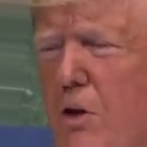
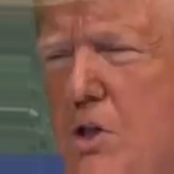
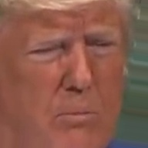
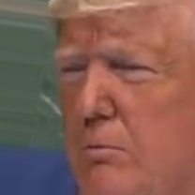
Extracted Images From Video 1

Slide 19
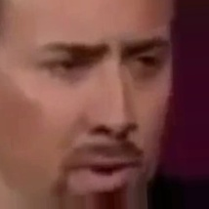
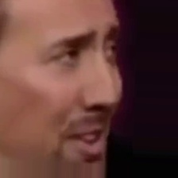

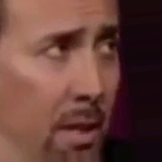
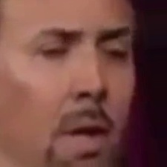
Extracted Images From Video 1

Slide 20
PROGRESS PART 2 Demo
Extract Binary Masks from Images

Slide 21
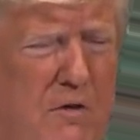
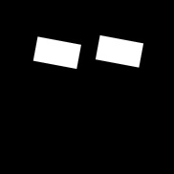
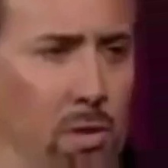

PRE-PROCESSED IMAGES
Binary Masks

Slide 22
Advantages of Face Alignment
Kalman filter smoothen the bounding box positions over frames and eliminate jitter on the swapped face

Slide 23
PROGRESS PART 3
Finalize on Architecture

Slide 24
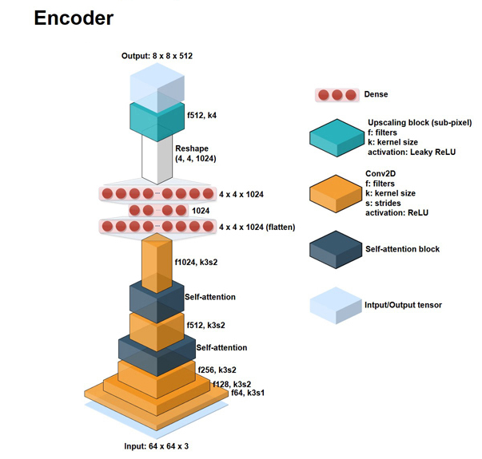
ARCHITECTURE:
SAGAN
Self-Attention Generative Adversarial Networks.
Benefits of GAN & Autoencoders
ENCODER
DECODER
WRAPPED IN GENERATOR
DISCRIMINATOR

Slide 25
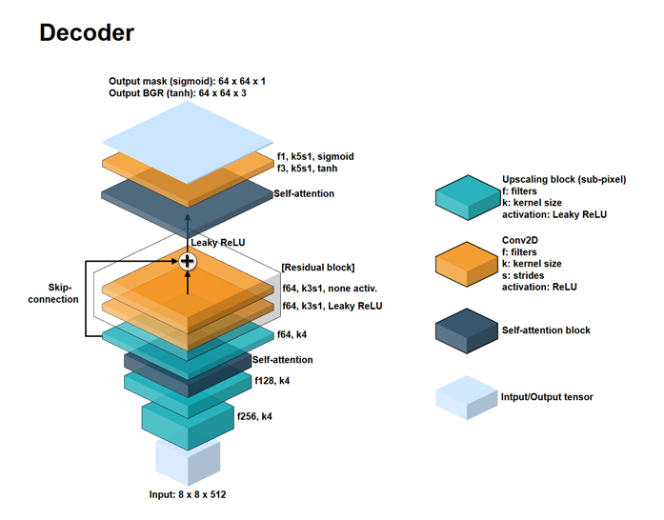

Slide 26
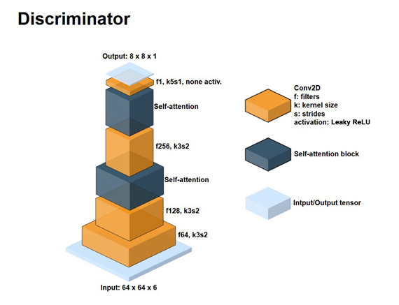

Slide 27

EXPECTED RESULT

Slide 28



Expected Results and Future Improvements
Generate swapped faces using the architecture
Construct video from images
Customized Face Swaps
Options to Choose from wide variety of personalities
28

Slide 29

Thank You

